Slide 1






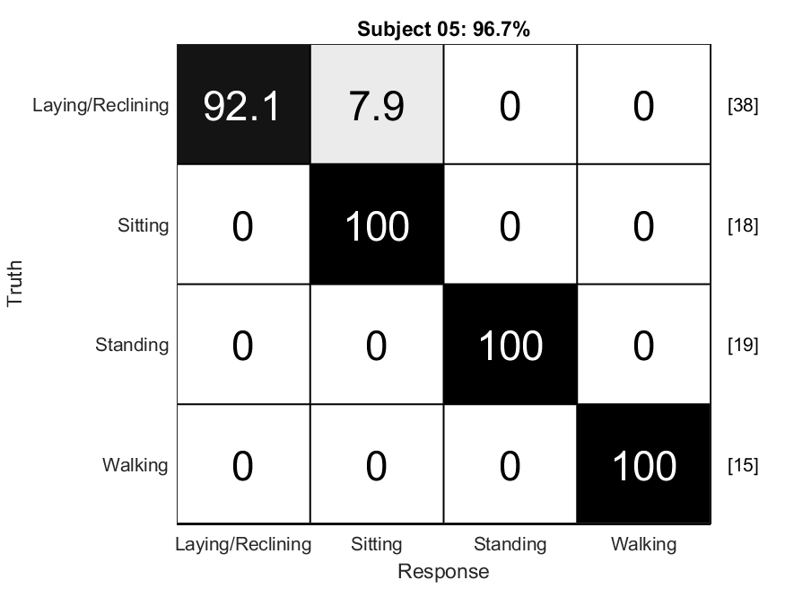
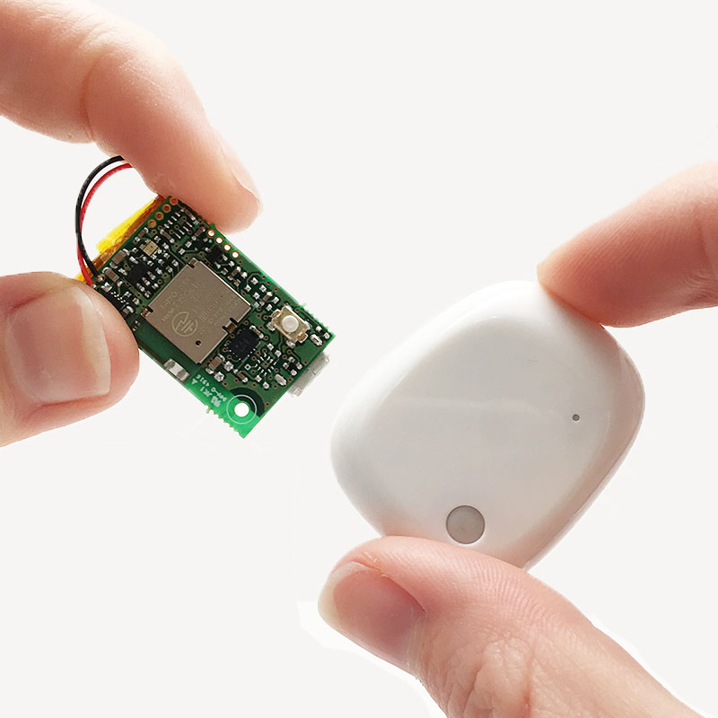
iMup: A Body Position Tracker for iOS
Sarah Moninger¹, Chandra Throckmorton, PhD⁴ , Leighanne Jarvis, BS¹
Juliessa Pavon, MD, MHS^{2, 5}, Kevin Caves, ME, ATP, RET^{1,2,3}
Duke University, ¹Department of Head and Neck Surgery & Communication Sciences
²Department of Medicine, ³Department of Biomedical Engineering, ⁴Signal Analysis Solutions, ⁵Durham VA Geriatrics (GRECC)
One-Thing-Straight (1TS)
Sarah Moninger¹, Jack Livingston² ,
Leighanne Jarvis, BS¹ , Mike Revoir⁴ , Kevin Caves, ME, ATP, RET^{1,3,4}
Duke University, ¹Department of Head and Neck Surgery & Communication Sciences
²ECE Undergrad, ³Department of Medicine, ⁴Department of Biomedical Engineering, Duke Institute of Health Innovation
Background
Operation
Background
Hospital stay duration is shortened by increased movement and posture improvement. Any angle increase is an improvement.
Sensors and Machine Learning can be used to detect and record body angle.
One or more sensors are attached to the patients’ bodies. The sensors stream accelerometer data to an iPad or iPhone. The device analyzes the input or saves the data, which can be downloaded and processed after collection.
Parkinson’s Disease (PD) patients can lose postural awareness resulting in a forward flexed posture.
Can lead to dangerous conditions such as falls.
PD patients can correct their posture with cueing.
Position Tracking
Screenshot
Software
1TS is an iOS application that uses a microcontroller-based sensor to track postural movements.
The sensor is worn on the user’s collar or in their front pocket. The accelerometer data is streamed to the user’s iPhone via Bluetooth.
The app on the phone uses a trigonometric algorithm to detect flexed or forward leaning posture. If a flexed posture is detected, the iPhone sends a notification to the user.
An animated display on the app shows the live angle of flexion and helps train the user to straighten their posture.
More Info
iMup @ livewellrerc.org
Walking
Sitting
Standing
1TS @ livewellrerc.org
As the patient rehabilitates, the app records the improvements in posture and the length of time spent in each position.
Mbient Sensors
Laying/Reclining
Commodity BluetoothBLE are used in both iMup and One Thing Straight.
Next Steps
Machine Learning Algorithm
Clinical testing with clinicians and patients
Recruit beta users with Parkinson’s Disease to test app
Finalize app for submission to Apple’s App Store
Assistance and Collaboration
1TS was developed in collaboration with Mike Revoir from the Duke Institute for Heath Innovation and Jack Livingston from the Rapid Health App Prototyping Center. Additional support was provided by the Duke Claude D. Pepper Older Americans Independence Center
Confusion Matrix of Patient’s Results
Random Forest Classifier Labels Data with Positions
MetamotionR by Mbient
The Rehabilitation Engineering Research Center for Information and Communication Technology Access (LiveWell RERC) is funded by a 5-year grant from the National Institute on Disability, Independent Living and Rehabilitation Research in the U.S. Department of Health and Human Services (grant number 90RE5023). The opinions are those of the LiveWell RERC and do not necessarily reflect those of the U.S. Department of Health and Human Services or NIDILRR. The Duke Claude D. Pepper Older Americans Independence Center Is supported by the National Institute on Aging at the National Institutes of Health (grant number P30AG028716 to HJC and MCM).
For More information or if you have project ideas, contact: leighanne.davis@duke.edu or
kevin.caves@duke.edu

